Slide 1
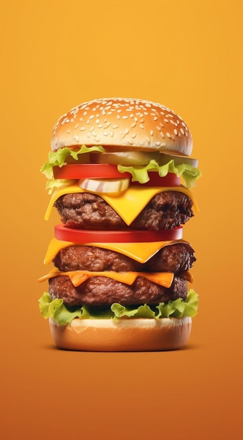
FAST - FOOD ANALYSIS (CDACL-004)
K.MOHAN CHAND
E.ROHINI KUMAR

Slide 2
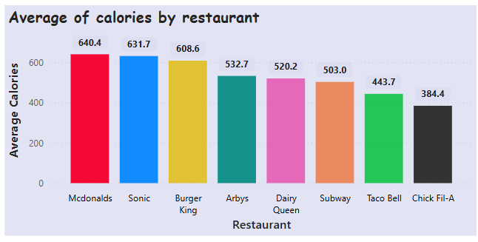
1. RESTAURANT-WIDE COMPARISON
I. Average of Calories by restaurant
> The bar chart illustrates the average calorie content of menu items from various fast-food restaurants.
> McDonald's leads with the highest average calorie count at 640.4 calories, followed closely by Sonic at 631.7 calories and Burger King at 608.6 calories. These three restaurants have significantly higher average calorie counts compared to others.
> Arby's, Dairy Queen, and Subway have moderate average calorie counts of 532.7, 520.2, and 503.0 calories respectively. Taco Bell and Chick Fil-A have the lowest average calorie counts, with Taco Bell at 443.7 calories and Chick Fil-A at 384.4 calories.
> This data suggests that McDonald's, Sonic, and Burger King offer higher-calorie menu items on average, which could be a consideration for health-conscious consumers. Conversely, Chick Fil-A and Taco Bell may be better options for those looking to consume fewer calories.
Fig 1 : Avg Calories by Restaurant

Slide 3
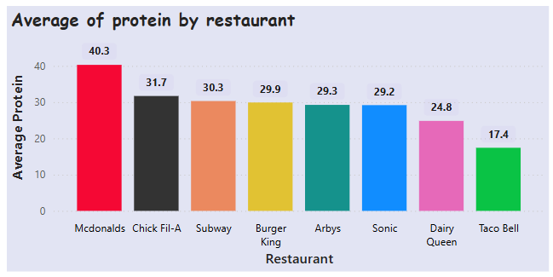
1. RESTAURANT-WIDE COMPARISON
II. Average of Protein by restaurant
> The bar chart illustrates the average protein content in meals from various fast-food restaurants.
> McDonald's leads with the highest average protein content at 40.3 grams, significantly higher than the other restaurants. Chick Fil-A follows with 31.7 grams, while Subway has an average of 30.3 grams.
> Burger King, Arby's, and Sonic have similar protein averages, with 29.9 grams, 29.3 grams, and 29.2 grams respectively. Dairy Queen's average protein content is 24.8 grams, and Taco Bell has the lowest at 17.4 grams.
> This data is relevant for individuals seeking high-protein meals from fast-food chains, highlighting McDonald's as the top choice for protein-rich options. The chart also shows a noticeable gap between the highest and lowest averages, indicating significant variability in protein content across different restaurants.
Fig 2 : Avg Protein by Restaurant

Slide 4
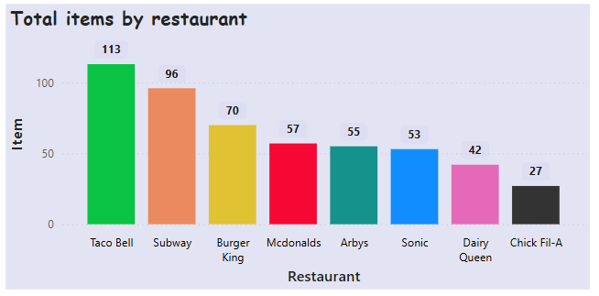
1. RESTAURANT-WIDE COMPARISON
III. Total Items by restaurant
> The bar chart titled "Total items by restaurant" provides a comparative analysis of the number of items offered by various fast-food restaurants.
> The chart reveals that Taco Bell leads with the highest number of items at 113, followed by Subway with 96 items. Burger King comes in third with 70 items.
> The middle range includes McDonald's with 57 items, Arby's with 55 items, and Sonic with 53 items. Dairy Queen and Chick fill-A offer fewer items, with 42 and 27 respectively. This data is interesting as it highlights the diversity in menu offerings across different fast-food chains, which could influence customer choice and satisfaction.
> The significant difference between Taco Bell and Chick-fil-A, with Taco Bell offering more than four times the number of items, is particularly noteworthy. This information can be relevant for market analysis, customer preference studies, and competitive strategy development in the fast-food industry.
Fig 3 : Total Items by Restaurant

Slide 5
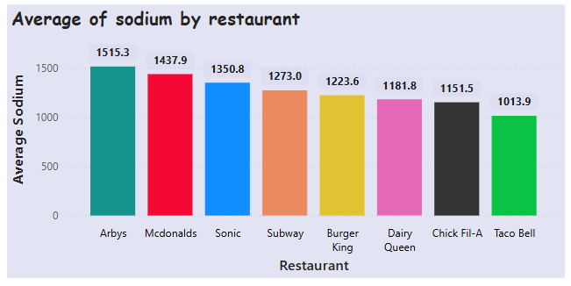
1. RESTAURANT-WIDE COMPARISON
IV. Average of Sodium by restaurant
> The bar chart illustrates the average sodium content in meals from various fast-food restaurants.
> The data reveals that Arby's has the highest average sodium content at 1515.3 mg followed closely by McDonald's at 1437.9 mg and Sonic at 1350.8 mg. Subway, often perceived as a healthier option, still has a significant average sodium content of 1273.0 mg. Burger King , Dairy Queen, and Chick Fil-A have average sodium contents of 1223.6 mg, 1181.8 mg, and 1151.5 mg respectively.
> Taco Bell has the lowest average sodium content among the listed restaurants at 1013.9 mg. This information is crucial for individuals monitoring their sodium intake, as it highlights that even popular fast-food chains with healthier reputations can have high sodium levels.
> The data underscores the importance of being mindful of sodium consumption when dining out, regardless of the restaurant's perceived healthiness. Generally, the lower limit of 1500 mg is often advised.
Fig 4 : Average of sodium by Restaurant

Slide 6
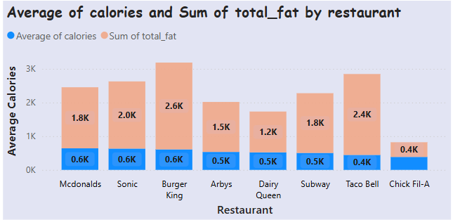
2. NUTRITIONAL INSIGHTS
I. Average of Calories and Sum of total_fat by Restaurant
> The chart titled "Average of calories and Sum of total fat by restaurant" provides a comparative analysis of the average calorie and total fat content across various fast-food restaurants.
> The data reveals that Burger King has the highest average calorie count at 2.6K and a total fat content of 0.6K, indicating that meals from Burger King are generally higher in calories. Taco Bell follows with an average calorie count of 2.4K and a total fat content of 0.4K. On the lower end, Chick Fil-A has the lowest average calorie count at 0.4K and a total fat content of 0.4K, suggesting that Chick Fil-A offers relatively lighter meal options.
> McDonald's, Sonic, and Subway have similar total fat counts of 1.8K, 2.0K, and 1.8K respectively, but differ in their average calories content, with McDonald's and Sonic both at 0.6K and Subway at 0.5K. Arby's and Dairy Queen have moderate total fat counts of 1.5K and 1.2K respectively, both with average calorie content of 0.5K.
> This chart highlights the nutritional differences among popular fast-food chains, which can help consumers make more informed dietary choices.
Fig 5 : Avg Calories and sum of total
fat by Restaurant

Slide 7
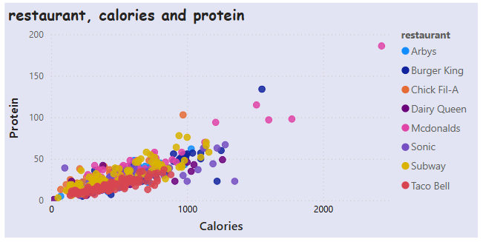
2. NUTRITIONAL INSIGHTS
II. Average of Calories and Sum of total_fat by Restaurant
> Analyzing the scatter plot of "restaurant, calories, and protein," we can observe several key insights.
> Most food items cluster around the lower end of the calorie and protein spectrum, indicating that the majority of items have lower calories and protein content. However, there are a few outliers with high protein content (above 100 grams) and varying calorie counts, particularly from McDonald's and Burger King.
> Restaurants like Subway and Chick Fil-A have a significant number of items with moderate to high protein content (between 50 and 100 grams) and calories ranging from 500 to 1000. Taco Bell and Sonic have fewer items with high protein content compared to other restaurants.
> The general trend shows that as the calorie content increases, the protein content also tends to increase, with exceptions such as high-calorie, low-protein items and low-calorie, high-protein items.
> These insights provide a comprehensive understanding of the nutritional content of food items across different fast-food restaurants.
Fig 6 : Calories and protein by Restaurant

Slide 8
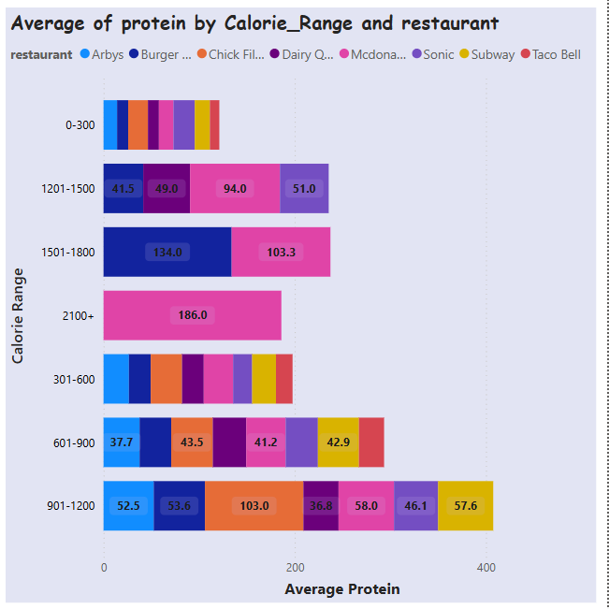
2. NUTRITIONAL INSIGHTS
III. Average of Protein by Calories_Range and Restaurant
> The bar chart titled "Average of protein by Calories Range and restaurant" reveals several insights about the protein content across different restaurants and calorie ranges.
> For the 601-900 calorie range, the average protein values are 37.7 grams for Arby's, 43.5 grams for Burger King, 41.2 grams for Chick-fil-A, and 42.9 grams for Dairy Queen.
> In the 901-1200 calorie range, the protein content varies significantly, with Chick-fil-A leading at 103.0 grams, followed by McDonald's at 58.0 grams, and Subway at 57.6 grams. For the 1201-1500 calorie range, Chick-fil-A maintains high protein levels at 94.0 grams, while McDonald's averages at 51.0 grams. Notably, in the 1501-1800 calorie range,
> Burger King reaches an average protein content of 134.0 grams, and in the 2100+ calorie range, Chick-fil-A stands out with 186.0 grams. These insights highlight the varying protein content across different calorie ranges and restaurants, allowing consumers to make informed choices based on their nutritional preferences.
Fig 7 : Average of Protein by Calories range
and Restaurant

Slide 9
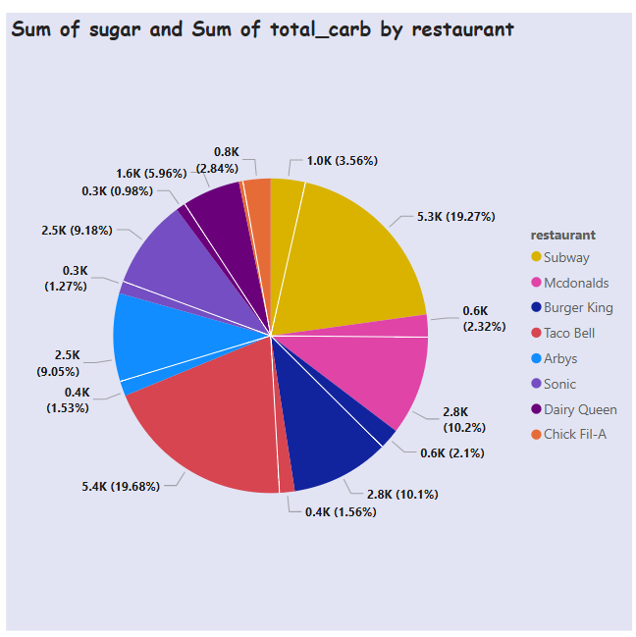
2. NUTRITIONAL INSIGHTS
IV. Sum of Sugar & Sum of tot_carb by restaurant
> The pie chart titled "Sum of sugar and Sum of total_carb by restaurant" presents data on the distribution of sugar and total carbohydrates across various fast-food restaurants.
> Notably, Subway and McDonald's emerge as significant contributors, each accounting for around 19% of the total sum, with values of 5.3K and 5.4K respectively. Burger King and Arby's follow with contributions of 9.18% (2.5K) and 9.05% (2.5K).
> Lesser contributors include Taco Bell (1.27%, 0.3K), Sonic (1.53%, 0.4K), Dairy Queen (5.96%, 1.6K), and Chick Fil-A (2.84%, 0.8K). This distribution highlights that Subway and McDonald's lead in sugar and carbohydrate content, while Taco Bell and Sonic are the lowest contributors.
> The visual clearly showcases the nutritional content across these popular fast-food chains, emphasizing the variations among them.
Fig 8 : Sum of sugar & Sum
of total carb by Restaurant

Slide 10
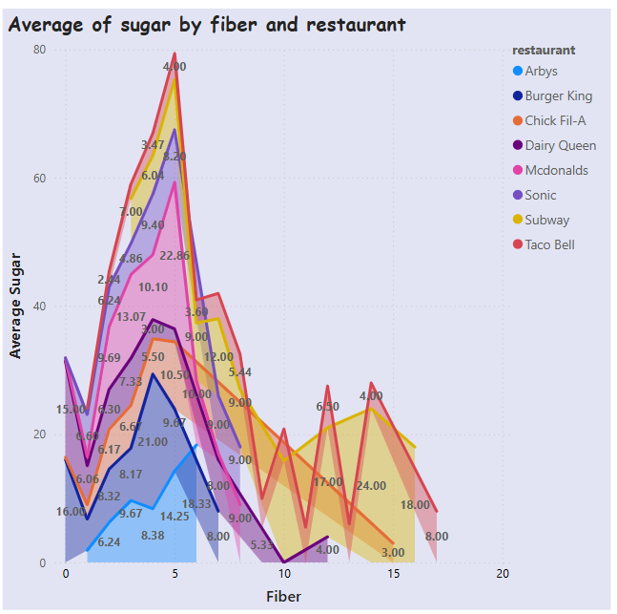
2. NUTRITIONAL INSIGHTS
V. Average of Sugar by fiber and restaurant
> The line graph titled "Average of sugar by fiber and restaurant" examines the relationship between fiber content and average sugar content across various fast-food restaurants. Key highlights include:
> McDonald's (pink) peaks at 4 grams of fiber with an average sugar content of 70 grams. Dairy Queen (red) shows a peak at 4 grams of fiber with 60 grams of average sugar. Subway (yellow) hits 5 grams of fiber with 22.86 grams of average sugar.
> Sonic (purple) has 3 grams of fiber with an average sugar content of 21 grams. Taco Bell (orange) peaks at 15 grams of fiber with 24 grams of sugar. Arby's (blue) shows 5 grams of fiber with 18.33 grams of sugar. Burger King (dark blue) peaks at 5 grams of fiber with 14.25 grams of sugar. Chick Fil-A (yellow) shows 4 grams of fiber with 10.10 grams of sugar. Overall, the chart reveals that higher fiber content generally correlates with lower sugar levels.
Fig 9 : Average of sugar by
fiber and Restaurant

Slide 11
2. NUTRITIONAL INSIGHTS
VI. Scatter plot on various fields over restaurant
> Let's break down the insights from each scatter plot in the image titled "Nutritional Insights":
1. Calories vs. Total Fat : There's a clear trend that higher calorie items tend to have more total fat. Items with fewer calories generally have lower fat content.
2. Protein vs. Calories : This plot shows that items with higher calorie counts also tend to have more protein. High-calorie fast-food items are often richer in protein.
3. Sodium vs. Cholesterol : This scatter plot indicates no significant correlation between sodium and cholesterol levels in fast-food items. High sodium does not necessarily imply high cholesterol.
4. Fiber vs. Sugar : Generally, higher fiber content corresponds to lower sugar levels. Healthier options with more fiber often contain less sugar.
5. Carbohydrates vs. Sugar : Fast-food items with higher carbohydrate content also tend to have more sugar. Carbs and sugar often go hand-in-hand in these items.
6. Total Fat vs. Saturated Fat : There is a strong association between total fat and saturated fat. Items higher in total fat are typically richer in saturated fat as well. These insights illustrate the nutritional trade-offs in fast-food items, helping consumers make informed dietary choices.

Slide 12
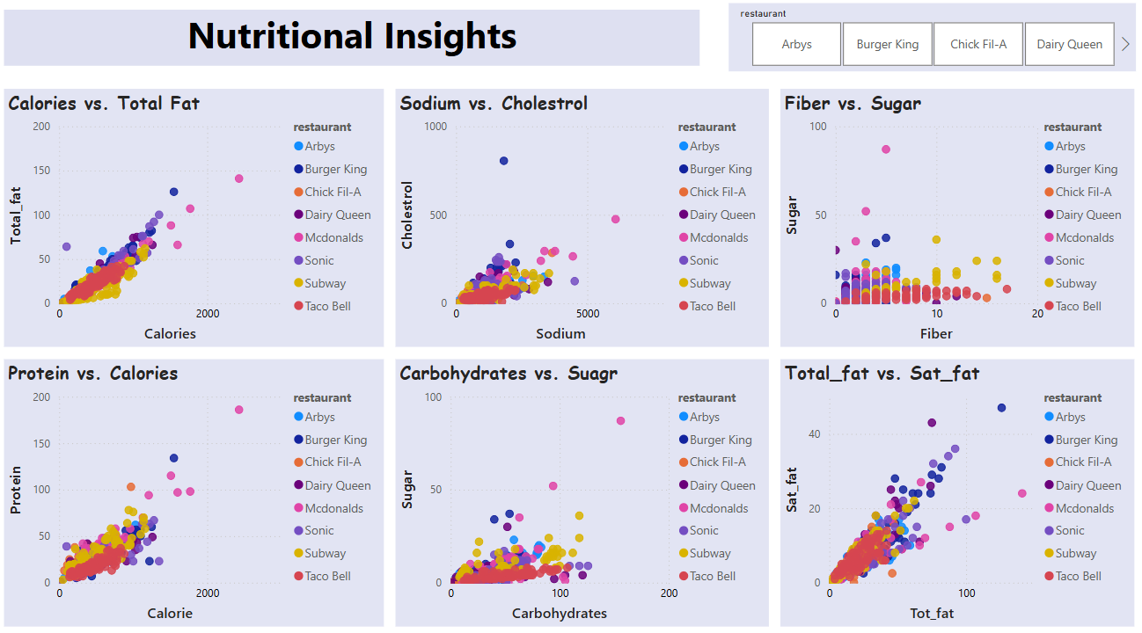
2. NUTRITIONAL INSIGHTS
Fig 10 : Scatter plots on various fields over Restaurant

Slide 13
2. NUTRITIONAL INSIGHTS
Cholesterol vs. Calories :
Most menu items cluster at the lower end of the cholesterol scale (0-500 mg) and the calorie scale (0-1000 calories).
Outliers with higher cholesterol and calorie values are particularly from Arby's and Chick Fil-A.
Items with higher calories tend to have higher cholesterol levels.
Sugar vs. Calories :
Most menu items cluster at the lower end of the sugar scale (0-50 grams) and the calorie scale (0-1000 calories).
Outliers with higher sugar and calorie values are mainly from Chick Fil-A.
Items with more calories generally have higher sugar content.
Bar Chart: Salad vs. Avg of Calories, Fat, Sodium :
Salad Category : Average of calories : 530.91, Average of total fat : 26.59, Average of sodium : 1246.74
Salads have a lower average calorie count (530.91) compared to other menu items. Salads have a significantly lower average total fat content (26.59) than other menu items. Salads have a higher average sodium content (1246.74) compared to other menu items, which could be attributed to dressings and toppings.

Slide 14
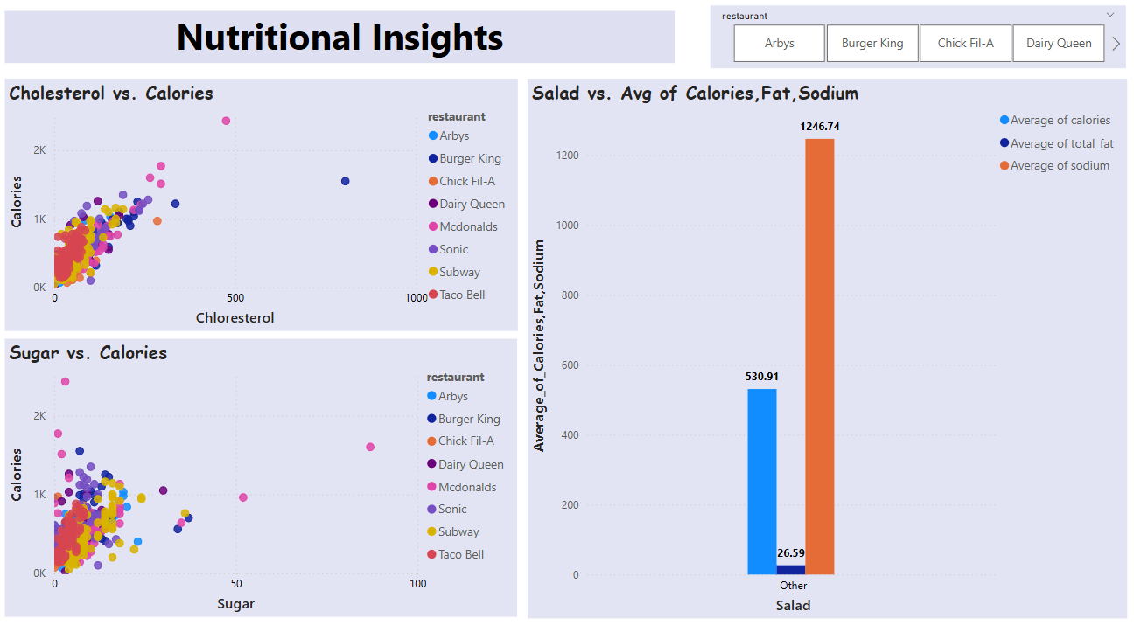
2. NUTRITIONAL INSIGHTS
Fig 11 : Scatter plots & Bar plot on various fields over Restaurant

Slide 15
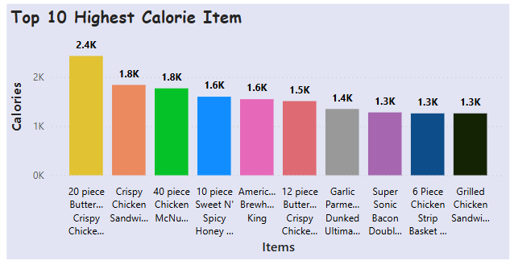
3. TOP 10 INSIGHTS OVER ITEMS
I. Top 10 Highest Calorie Items
> The bar chart titled "Top 10 Highest Calorie Item" showcases the calorie content of various fast-food items.
> Leading the list is "20-piece Buttermilk Crispy Chicken Tenders" with a whopping 2.4K calories. Following closely are "Crispy Chicken Sandwich" and "40-piece Chicken McNuggets", both at 1.8K calories.
> The "10-piece Sweet N' Spicy Honey BBQ Glazed " and "American Brewhouse" items each have 1.6K calories. The "12-piece Buttermilk Crispy Chicken Tenders" stands at 1.5K calories, while the "Garlic Parmesan Dunked Ultimate Chicken" is at 1.4K calories.
> Both "Super Sonic Bacon Double Cheeseburger" and "6 Piece Chicken Strip Basket w/ Country" have 1.3K calories, as does the "Grilled Chicken Sandwich". This data highlights the substantial calorie counts of these popular fast-food options, which is essential for those mindful of their calorie intake.
Fig 12 : Top 10 Highest Calorie Items

Slide 16
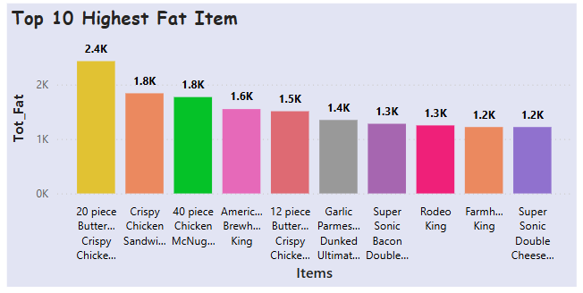
3. TOP 10 INSIGHTS OVER ITEMS
II. Top 10 Highest Fat Items
> The bar chart titled "Top 10 Highest Fat Item" illustrates the total fat content of various fast-food items.
> "20-piece Butter Crispy Chicken" leads with 2.4K total fat, followed by "Crispy Chicken Sandwich" and "40-piece Chicken McNuggets", each with 1.8K total fat. The "American Brewhouse King" contains 1.6K, while the "12-piece Butter Crispy Chicken" has 1.5K total fat.
> The "Garlic Parmesan Dunked Ultimate" has 1.4K, and both "Super Sonic Bacon Double" and "Rodeo King" feature 1.3K total fat. The "Farmhouse King" and "Super Sonic Double Cheeseburger" round out the list with 1.2K total fat each. This data emphasizes the high-fat content in these items, essential for those monitoring their dietary fat intake.
> Items with 1.8K calories, like "Crispy Chicken Sandwich" and "40-piece Chicken McNuggets", are also substantial. Overall, these items have substantial calorie counts, highlighting the need for mindful consumption for those monitoring their calorie intake.
Fig 13 : Top 10 Highest Fat Items

Slide 17
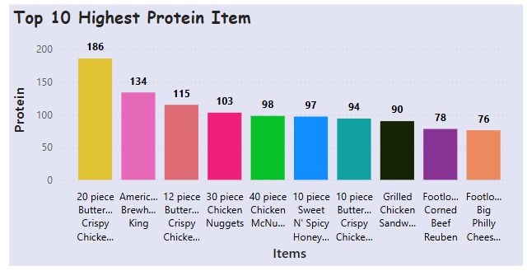
3. TOP 10 INSIGHTS OVER ITEMS
III. Top 10 Highest Protein Items
> The bar chart titled "Top 10 Highest Protein Item" highlights the protein content in various fast-food items. Leading the list is "20-piece Butter Crispy Chicken" with an impressive 186 grams of protein.
> Following closely are "American Brewhouse King" with 134 grams and "12-piece Butter Crispy Chicken" at 115 grams. Other high-protein items include "30-piece Chicken Nuggets" (103 grams), "40-piece Chicken McNuggets" (98 grams), and "10-piece Sweet N' Spicy Honey Chicken" (97 grams).
> The "10-piece Butter Crispy Chicken" offers 94 grams of protein, while the "Grilled Chicken Sandwich" provides 90 grams. Rounding out the list are "Footlong Corned Beef Reuben" (78 grams) and "Footlong Big Philly Cheesesteak" (76 grams).
> This data is useful for those seeking high-protein options, emphasizing the significant protein content in these items.
Fig 14 : Top 10 Highest Protein Items

Slide 18
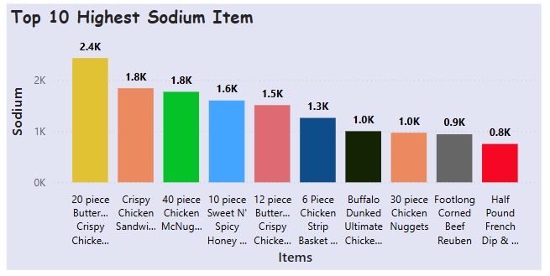
3. TOP 10 INSIGHTS OVER ITEMS
IV. Top 10 Highest Sodium Items
> The bar chart titled "Top 10 Highest Sodium Items" highlights the sodium content in various fast-food items. Leading the list is "20-piece Butter Crispy Chicken" with an enormous 2.4K sodium.
> Following closely are "Crispy Chicken Sandwich" and "40-piece Chicken McNuggets", each with 1.8K sodium. The "10-piece Sweet N' Spicy Honey Chicken" contains 1.6K sodium, while the "12-piece Butter Crispy Chicken" has 1.5K sodium.
> The "6 Piece Chicken Strip Basket" is at 1.3K sodium, and the "Buffalo Dunked Ultimate Chicken" shows 1.0K sodium. Both "30-piece Chicken Nuggets" and "Footlong Corned Beef Reuben" have 1.0K sodium and 0.9K sodium respectively.
> Finally, the "Half Pound French Dip" rounds out the list with 0.8K sodium. This data underscores the high sodium content in these fast-food items, which is crucial for individuals monitoring their sodium intake for health reasons.
Fig 15 : Top 10 Highest Sodium Items

Slide 19
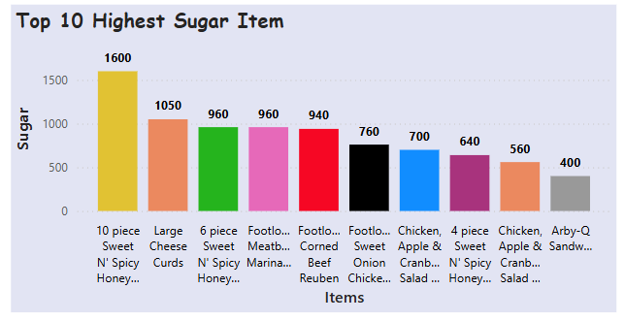
3. TOP 10 INSIGHTS OVER ITEMS
V. Top 10 Highest Sugar Items
> The bar chart titled "Top 10 Highest Sugar Items" reveals the sugar content of various fast-food items. Leading the list is the "10-piece Sweet N' Spicy Honey" with a staggering 1600 grams of sugar.
> Following closely is the "Large Cheese Curds" at 1050 grams. Both the "6-piece Sweet N' Spicy Honey" and the "Footlong Meatball Marinara" contain 960 grams of sugar each.
> The "Footlong Corned Beef Reuben" has 940 grams, while the "Footlong Sweet Onion Chicken Teriyaki" comes in at 760 grams. The "Chicken, Apple & Cranberry Salad" offers 700 grams of sugar. The "4 -piece Sweet N' Spicy Honey" has 640 grams, another "Chicken, Apple & Cranberry Salad" features 560 grams, and the "Arby-Q Sandwich" contains 400 grams of sugar.
> This data highlights the significant sugar content in these popular fast-food items, which is crucial for individuals monitoring their sugar intake.
Fig 16 : Top 10 Highest Sugar Items

Slide 20
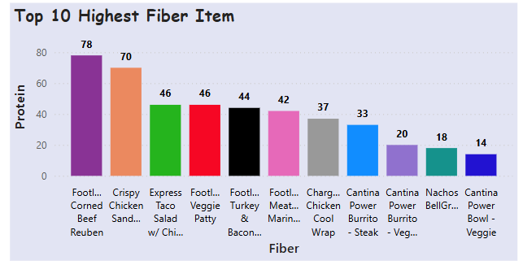
3. TOP 10 INSIGHTS OVER ITEMS
VI. Top 10 Highest Fiber Items
> The bar chart titled "Top 10 Highest Fiber Items" highlights the fiber content of various fast-food items. Leading the list is the "Footlong Corned Beef Reuben" with 78 grams of fiber.
> Following it is the "Crispy Chicken Sandwich" with 70 grams. The "Express Taco Salad with Chicken" and the "Footlong Veggie Patty" both contain 46 grams of fiber each. The "Footlong Turkey & Bacon" has 44 grams, while the "Footlong Meatball Marinara" comes in at 42 grams.
> The "Charged Chicken Cool Wrap" offers 37 grams of fiber. The "Cantina Power Burrito - Steak" has 33 grams, and the "Cantina Power Burrito - Veggie" features 20 grams.
> Finally, the "Nachos BellGrande" rounds out the list with 18 grams of fiber. This data is useful for those seeking high-fiber options, highlighting the significant fiber content in these items.
Fig 17 : Top 10 Highest Fiber Items

Slide 21
3. TOP 10 INSIGHTS OVER ITEMS
Healthiest Foods
Crispy Chicken Sandwich leads as a healthy option, featuring 1.8K calories and 3.4K protein. It's followed by the Express Taco Salad w/ Chips, which offers 2.5K calories and 1.9K protein. Both items also have low fat (1.2K) and low sodium (1.0K) contents, making them nutritious choices.
Unhealthiest Foods
On the other hand, Large Cheese Curds tops the list of unhealthiest foods with 2.5K calories, 2.0K fat, and 1.5K sugar. The Chicken Nuggets come next with 2.3K calories, 1.9K fat, and 1.2K sugar. Both items have high sodium content (2.0K and 1.8K respectively), highlighting their less nutritious nature.
These insights can guide you towards making healthier fast-food choices based on their nutritional content.

Slide 22
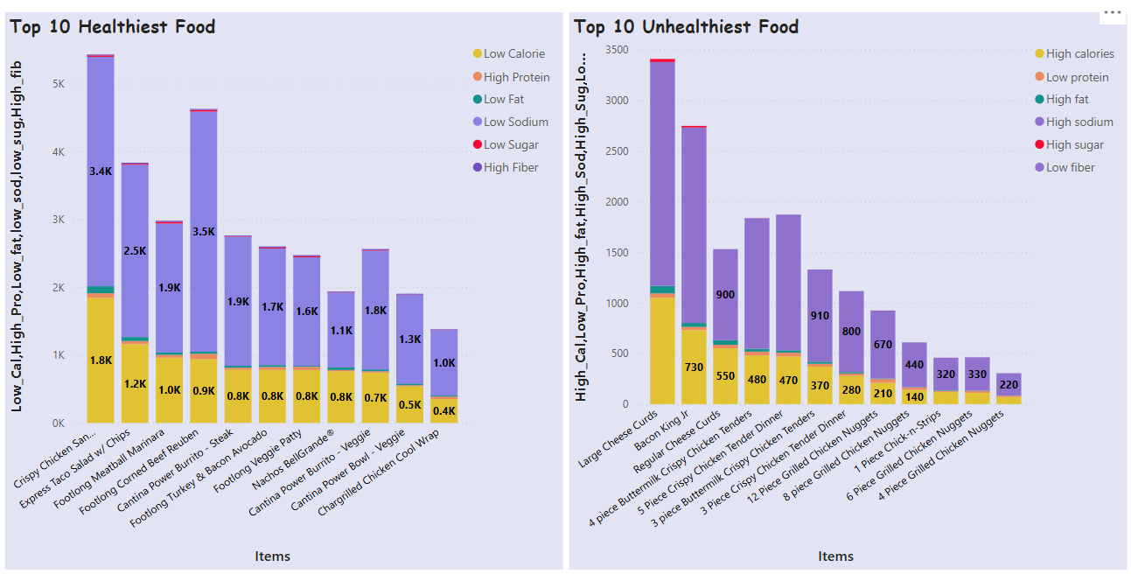
3. TOP 10 INSIGHTS OVER ITEMS
Fig 18 : Top 10 Healthiest and Unhealthiest Food

Slide 23
THANK YOU

